Slide 1
9
Muscles and Muscle Tissues: Part C

Slide 2
Force of Muscle Contraction
Force of contraction depends on number of cross bridges attached, which is affected by
    Number of muscle fibers stimulated (recruitment)
    Relative size of fibers—hypertrophy of cells increases strength
    Frequency of stimulation
    Degree of muscle stretch

Slide 3
Force of Muscle Contraction
As more muscle fibers are recruited (as more are stimulated) → more force
Relative size of fibers – bulkier muscles & hypertrophy of cells → more force
Frequency of stimulation - ↑ frequency → time for transfer of tension to noncontractile components → more force
Length-tension relationship – muscle fibers at 80–120% normal resting length → more force

Slide 4
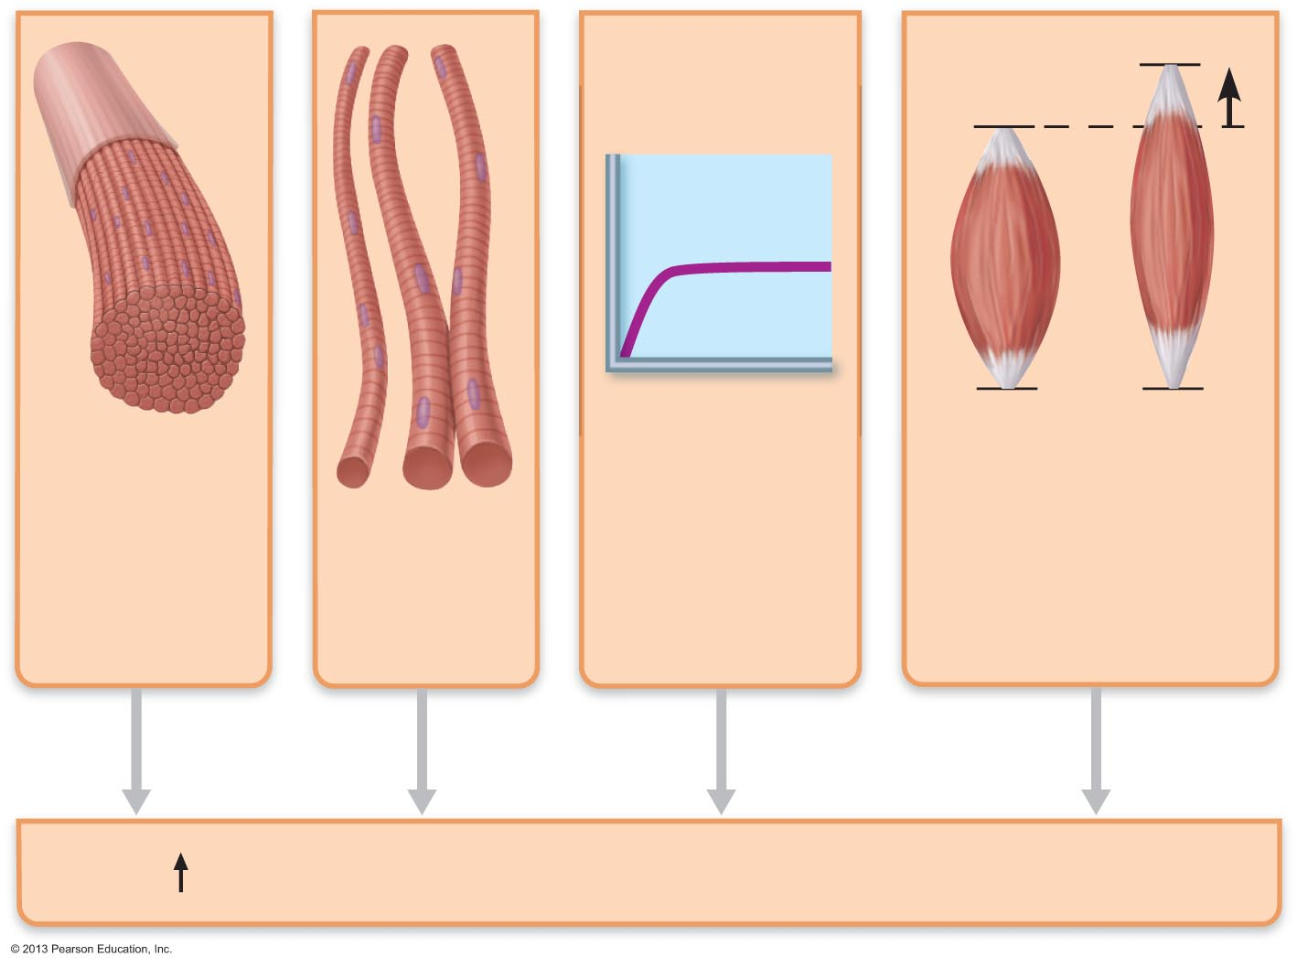
Figure 9.21 Factors that increase the force of skeletal muscle contraction.
High
frequency of
stimulation
(wave
summation
and tetanus)
Large
number of
muscle
fibers
recruited
Muscle and
sarcomere
stretched to
slightly over 100%
of resting length
Large
muscle
fibers
Contractile force (more cross bridges attached)

Slide 5
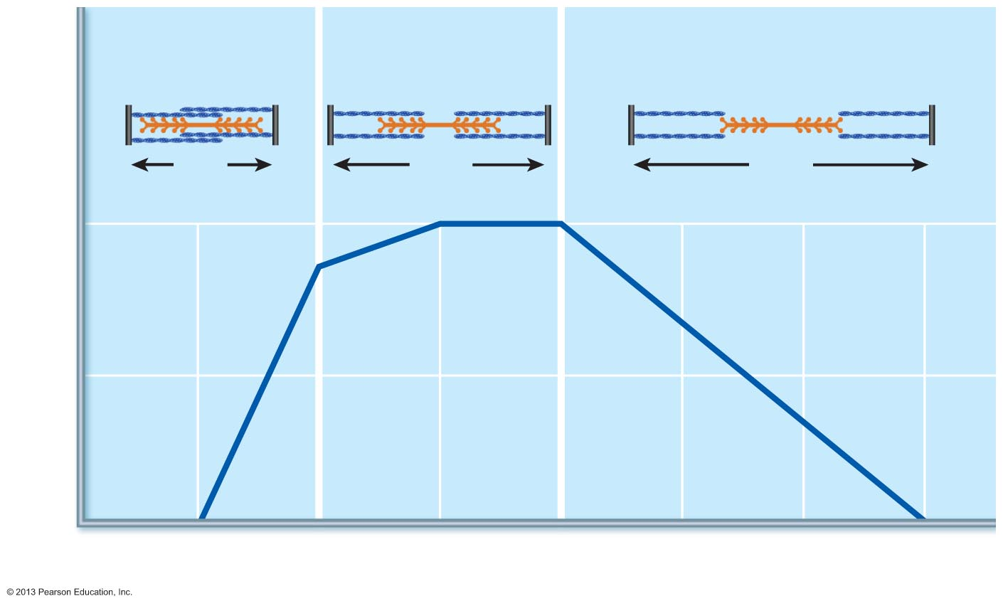
Figure 9.22 Length-tension relationships of sarcomeres in skeletal muscles.
Sarcomeres
greatly
shortened
Sarcomeres at
resting length
Sarcomeres excessively
stretched
75%
100%
170%
100
Tension (percent of maximum)
Optimal sarcomere
operating length
(80%–120% of
resting length)
50
0
60
80
100
120
140
160
180
Percent of resting sarcomere length

Slide 6
Velocity and Duration of Contraction
Influenced by:
  Muscle fiber type
  Load
  Recruitment

Slide 7
Muscle Fiber Type
Classified according to two characteristics
  Speed of contraction: slow or fast fibers according to
    Speed at which myosin ATPases split ATP
    Pattern of electrical activity of motor neurons
  Metabolic pathways for ATP synthesis
    Oxidative fibers—use aerobic pathways
    Glycolytic fibers—use anaerobic glycolysis

Slide 8
Muscle Fiber Type
Three types
  Slow oxidative fibers; Fast oxidative fibers; Fast glycolytic fibers
Most muscles contain mixture of fiber types → range of contractile speed, fatigue resistance
  All fibers in one motor unit same type
  Genetics dictate individual's percentage of each

Slide 9
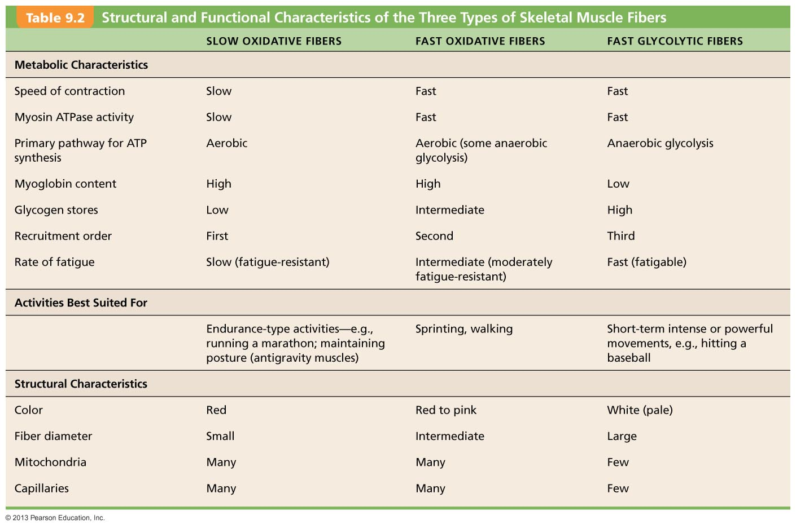
Table 9.2 Structural and Functional Characteristics of the Three Types of Skeletal Muscle Fibers

Slide 10
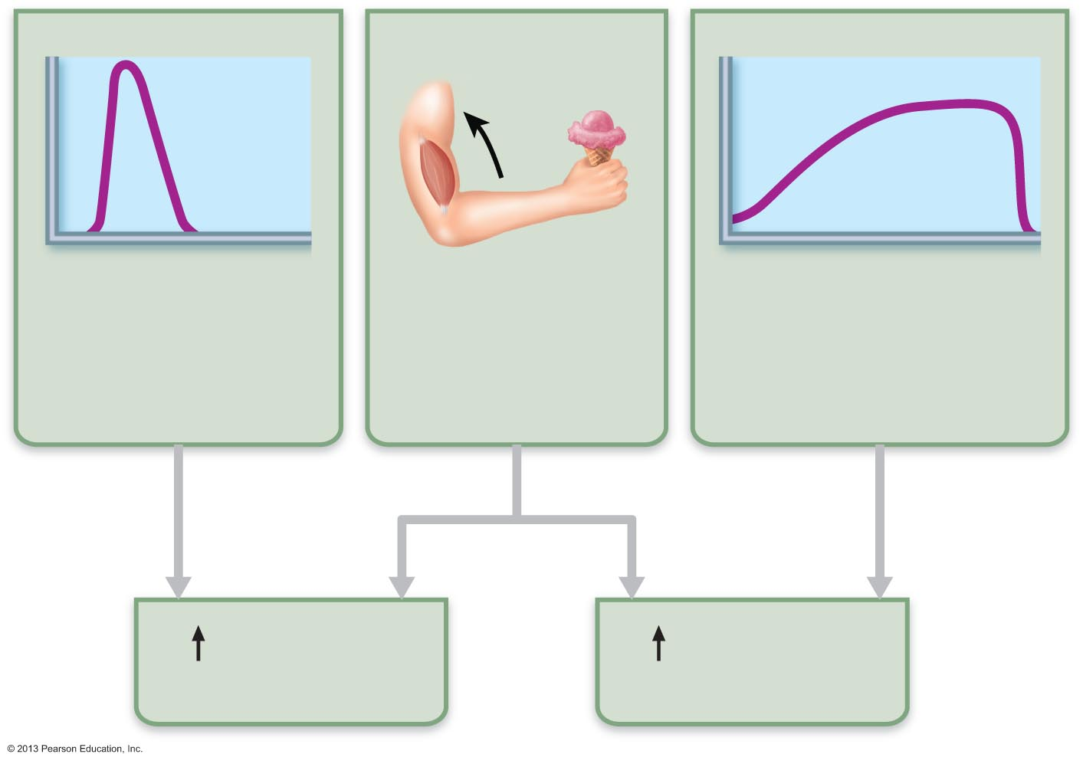
Figure 9.23 Factors influencing velocity and duration of skeletal muscle contraction.
Predominance
of fast glycolytic
(fatigable) fibers
Small load
Predominance
of slow oxidative
(fatigue-resistant)
fibers
Contractile
velocity
Contractile
duration

Slide 11
Influence of Load
Muscles contract fastest when no load added
↑ load → ↑ latent period, slower contraction, and ↓ duration of contraction

Slide 12
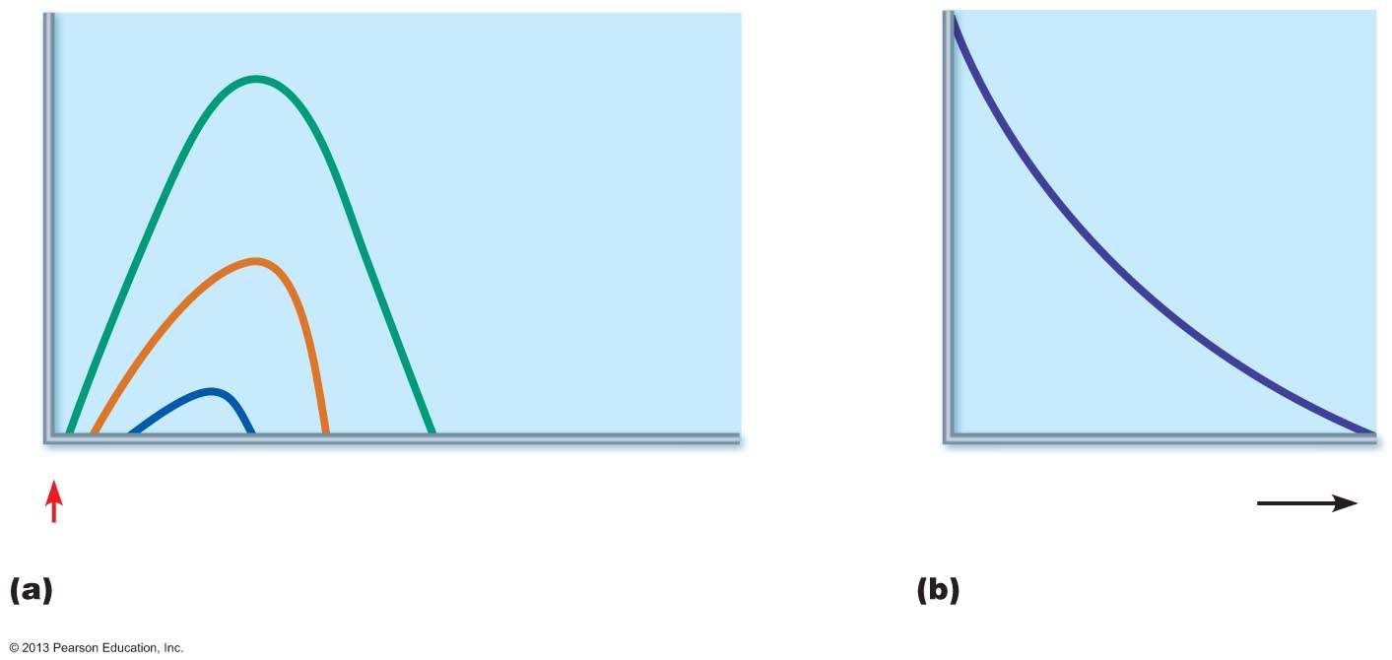
Figure 9.24 Influence of load on duration and velocity of muscle contraction.
Light load
Distance shortened
Intermediate load
Velocity of shortening
Heavy load
0
20
40
60
80
100
120
0
Time (ms)
Increasing load
Stimulus
The greater the load, the less the muscle shortens
and the shorter the duration of contraction
The greater the load, the
slower the contraction

Slide 13
Influence of Recruitment
Recruitment → faster contraction and ↑ duration of contraction

Slide 14
Adaptations to Exercise
Aerobic (endurance) exercise
  Leads to increased
    Muscle capillaries
    Number of mitochondria
    Myoglobin synthesis
  Results in greater endurance, strength, and resistance to fatigue
  May convert fast glycolytic fibers into fast oxidative fibers

Slide 15
Effects of Resistance Exercise
Resistance exercise (typically anaerobic) results in
  Muscle hypertrophy
    Due primarily to increase in fiber size
  Increased mitochondria, myofilaments, glycogen stores, and connective tissue
  → Increased muscle strength and size

Slide 16
A Balanced Exercise Program
Overload principle
  Forcing muscle to work hard promotes increased muscle strength and endurance
  Muscles adapt to increased demands
  Muscles must be overloaded to produce further gains
  Overuse injuries may result from lack of rest
  Best programs alternate aerobic and anaerobic activities

Slide 17
Homeostatic Imbalance
Disuse atrophy
  Result of immobilization
  Muscle strength declines 5% per day
Without neural stimulation muscles atrophy to ¼ initial size
  Fibrous connective tissue replaces lost muscle tissue → rehabilitation impossible

Slide 18
Smooth Muscle
Found in walls of most hollow organs
(except heart)
Usually in two layers (longitudinal and circular)

Slide 19
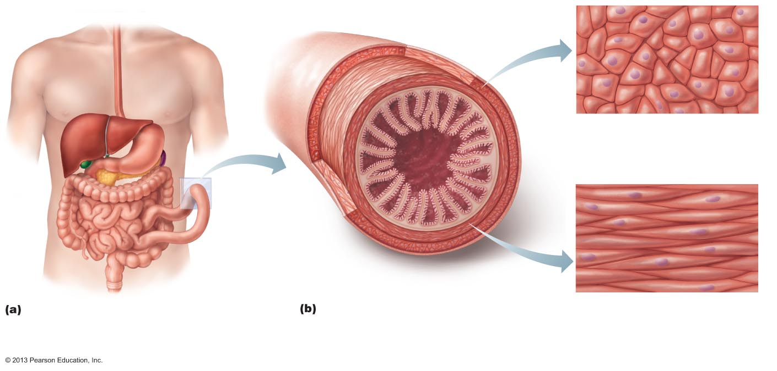
Figure 9.25 Arrangement of smooth muscle in the walls of hollow organs.
Longitudinal layer of smooth
muscle (shows smooth muscle
fibers in cross section)
Small intestine
Mucosa
Cross section of the intestine showing
the smooth muscle layers (one circular
and the other longitudinal) running at
right angles to each other.
Circular layer of smooth muscle
(shows longitudinal views of smooth
muscle fibers)

Slide 20
Microscopic Structure
Spindle-shaped fibers - thin and short compared with skeletal muscle fibers; only one nucleus; no striations
Lacks connective tissue sheaths; endomysium only
SR - less developed than in skeletal muscle
Pouchlike infoldings (caveolae) of sarcolemma sequester Ca²⁺ - most calcium influx from outside cell; rapid
No sarcomeres, myofibrils, or T tubules

Slide 21
Microscopic Structure of Smooth Muscle Fibers
Longitudinal layer
  Fibers parallel to long axis of organ; contraction → dilates and shortened
Circular layer
  Fibers in circumference of organ; contraction → constricts lumen, elongates organ
Allows peristalsis - Alternating contractions and relaxations of smooth muscle layers that mix and squeeze substances through lumen of hollow organs

Slide 22
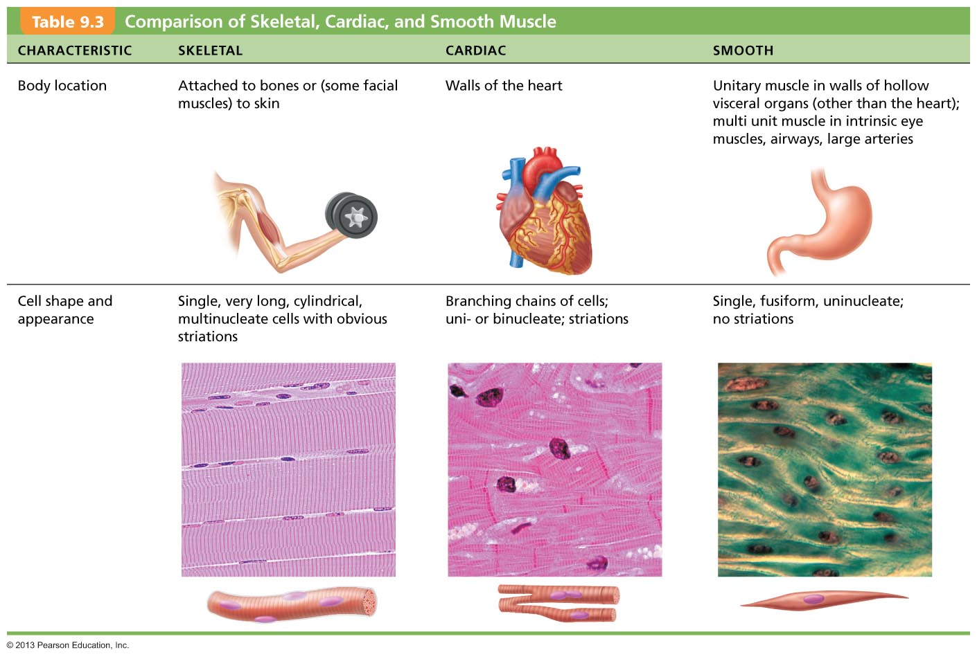
Table 9.3 Comparison of Skeletal, Cardiac, and Smooth Muscle (1 of 4)

Slide 23
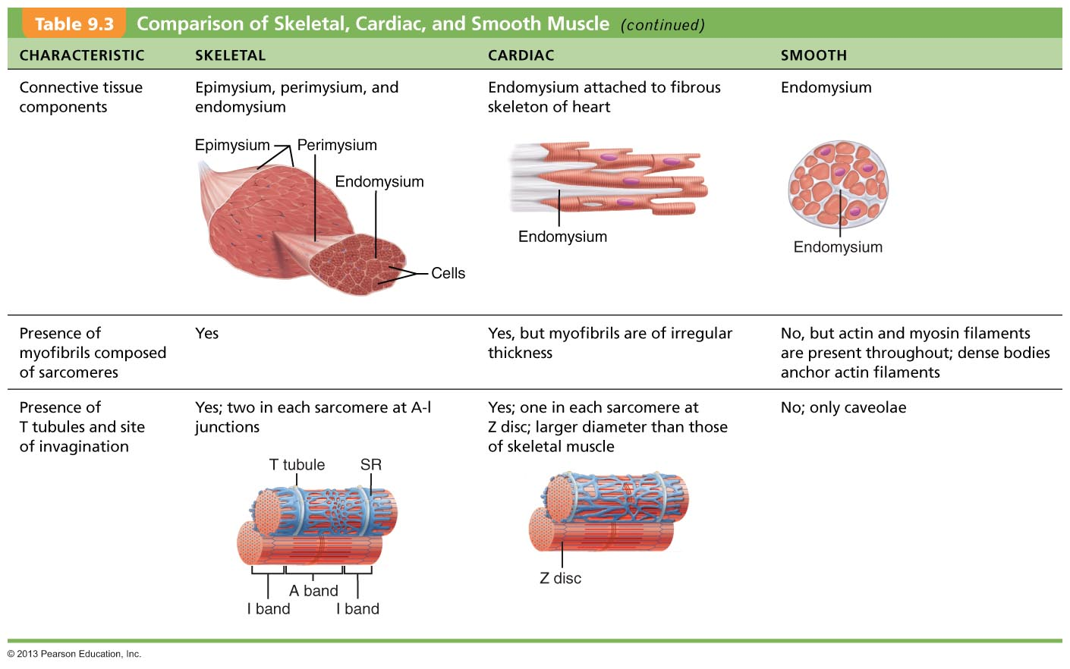
Table 9.3 Comparison of Skeletal, Cardiac, and Smooth Muscle (2 of 4)

Slide 24
Innervation of Smooth Muscle
No NMJ as in skeletal muscle
Autonomic nerve fibers innervate smooth muscle at diffuse junctions
Varicosities (bulbous swellings) of nerve fibers store and release neurotransmitters into diffuse junctions

Slide 25
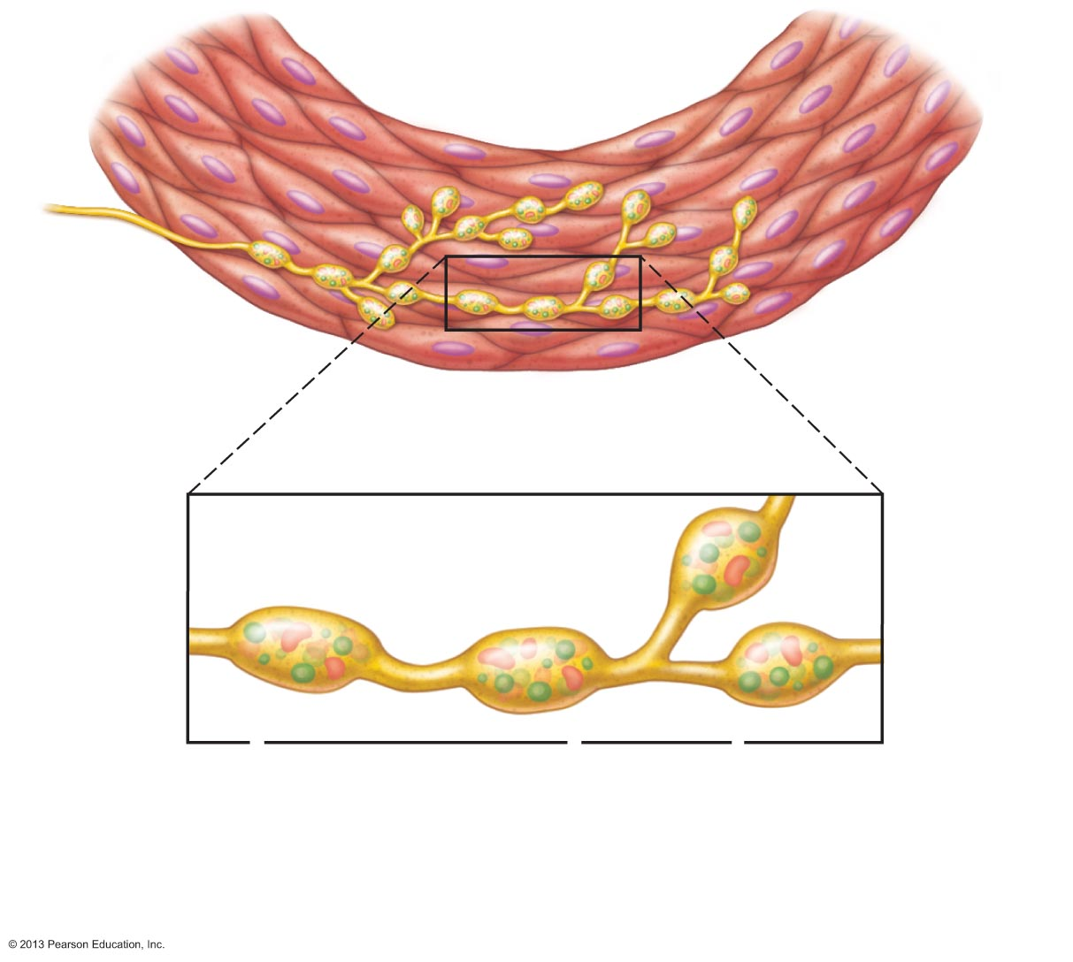
Figure 9.26 Innervation of smooth muscle.
Varicosities
Autonomic
nerve fibers
innervate
most smooth
muscle fibers.
Smooth
muscle
cell
Synaptic
vesicles
Mitochondrion
Varicosities release
their neurotransmitters
into a wide synaptic
cleft (a diffuse junction).

Slide 26
Myofilaments in Smooth Muscle
Ratio of thick to thin filaments (1:13) is much lower than in skeletal muscle (1:2)
Thick filaments have heads along entire length
No troponin complex; protein calmodulin binds Ca²⁺

Slide 27
Myofilaments in Smooth Muscle
Myofilaments are spirally arranged, causing smooth muscle to contract in corkscrew manner
Dense bodies
  Proteins that anchor noncontractile intermediate filaments to sarcolemma at regular intervals
  Correspond to Z discs of skeletal muscle

Slide 28
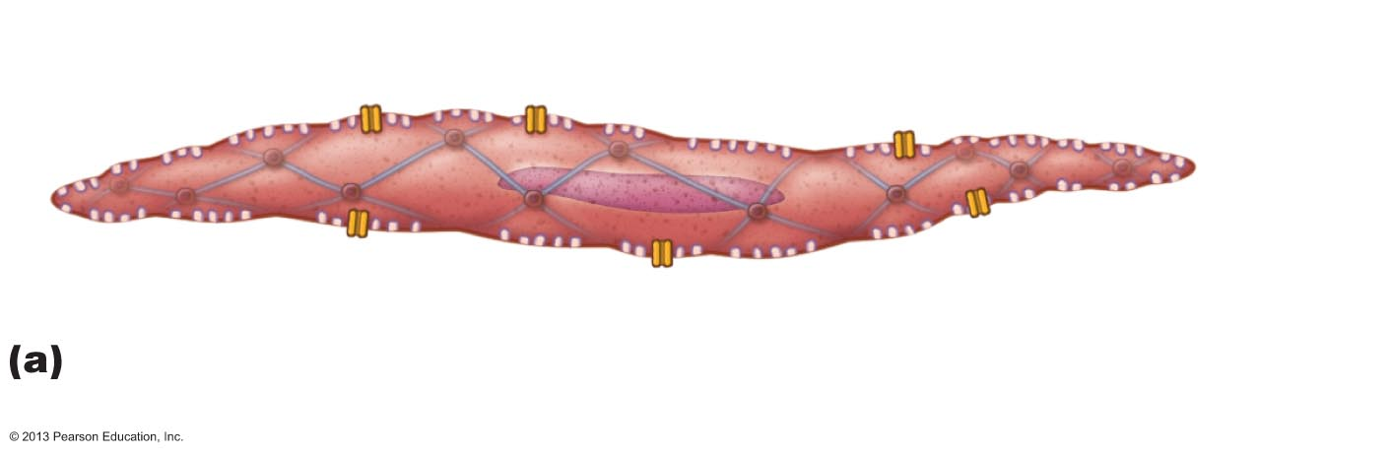
Figure 9.27a Intermediate filaments and dense bodies of smooth muscle fibers harness the pull generated by myosin
cross bridges.
Intermediate
filament
Caveolae
Gap junctions
Nucleus
Dense bodies
Relaxed smooth muscle fiber (note that gap junctions connect
adjacent fibers)

Slide 29
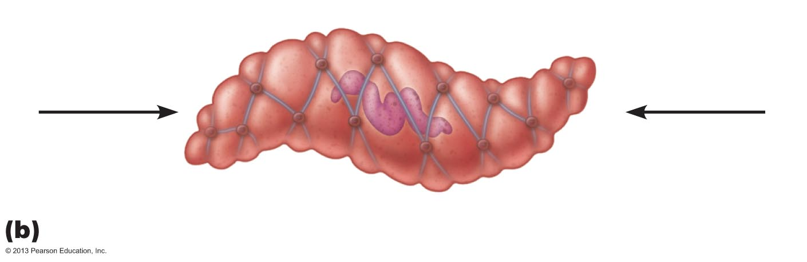
Figure 9.27b Intermediate filaments and dense bodies of smooth muscle fibers harness the pull generated by myosin
cross bridges.
Nucleus
Dense bodies
Contracted smooth muscle fiber

Slide 30
Contraction of Smooth Muscle
Slow, synchronized contractions
Cells electrically coupled by gap junctions
  Action potentials transmitted from fiber to fiber
Some cells self-excitatory (depolarize without external stimuli); act as pacemakers for sheets of muscle
  Rate and intensity of contraction may be modified by neural and chemical stimuli

Slide 31
Contraction of Smooth Muscle
Actin and myosin interact by sliding filament mechanism
Final trigger is ↑ intracellular Ca²⁺
  Ca²⁺ is obtained from the SR and extracellular space
ATP energizes sliding process

Slide 32
Role of Calcium Ions
Ca²⁺ binds to and activates calmodulin
Activated calmodulin activates myosin (light chain) kinase →
Phosphorylates and activates myosin
Cross bridges interact with actin
When intracellular Ca²⁺ levels drop → relaxation

Slide 33
Table 9.3 Comparison of Skeletal, Cardiac, and Smooth Muscle (2 of 4)

Slide 34
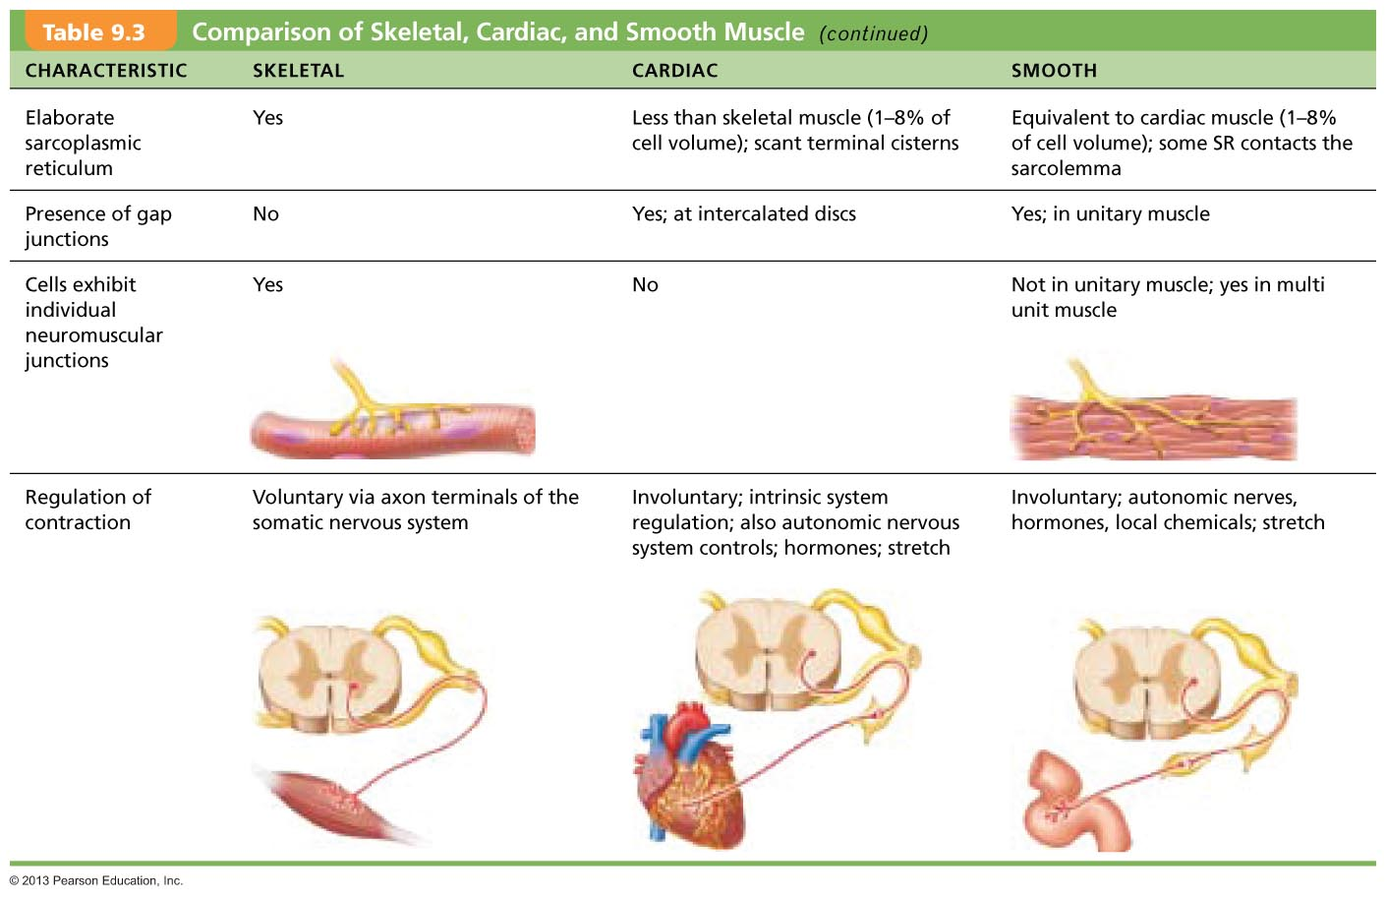
Table 9.3 Comparison of Skeletal, Cardiac, and Smooth Muscle (3 of 4)

Slide 35
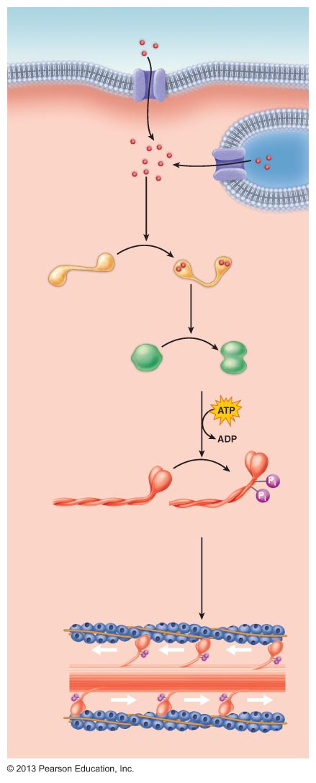
Figure 9.28 Sequence of events in excitation-contraction coupling of smooth muscle.
Slide 1
Extracellular fluid (ECF)
Ca²⁺
Plasma membrane
Cytoplasm
Calcium ions (Ca²⁺)
enter the cytosol from
the ECF via voltage-
dependent or voltage-
independent Ca²⁺
channels, or from
the scant SR.
1
Ca²⁺
Ca²⁺ binds to and
activates calmodulin.
Sarcoplasmic
reticulum
2
Ca²⁺
Inactive calmodulin
Activated calmodulin
Activated calmodulin
activates the myosin
light chain kinase
enzymes.
3
Inactive kinase
Activated kinase
The activated kinase
enzymes catalyze transfer
of phosphate to myosin,
activating the myosin
ATPases.
4
Inactive myosin
molecule
Activated (phosphory-
lated) myosin molecule
Activated myosin forms
cross bridges with actin of the
thin filaments. Shortening
begins.
5
Thin
filament
Thick
filament

Slide 36
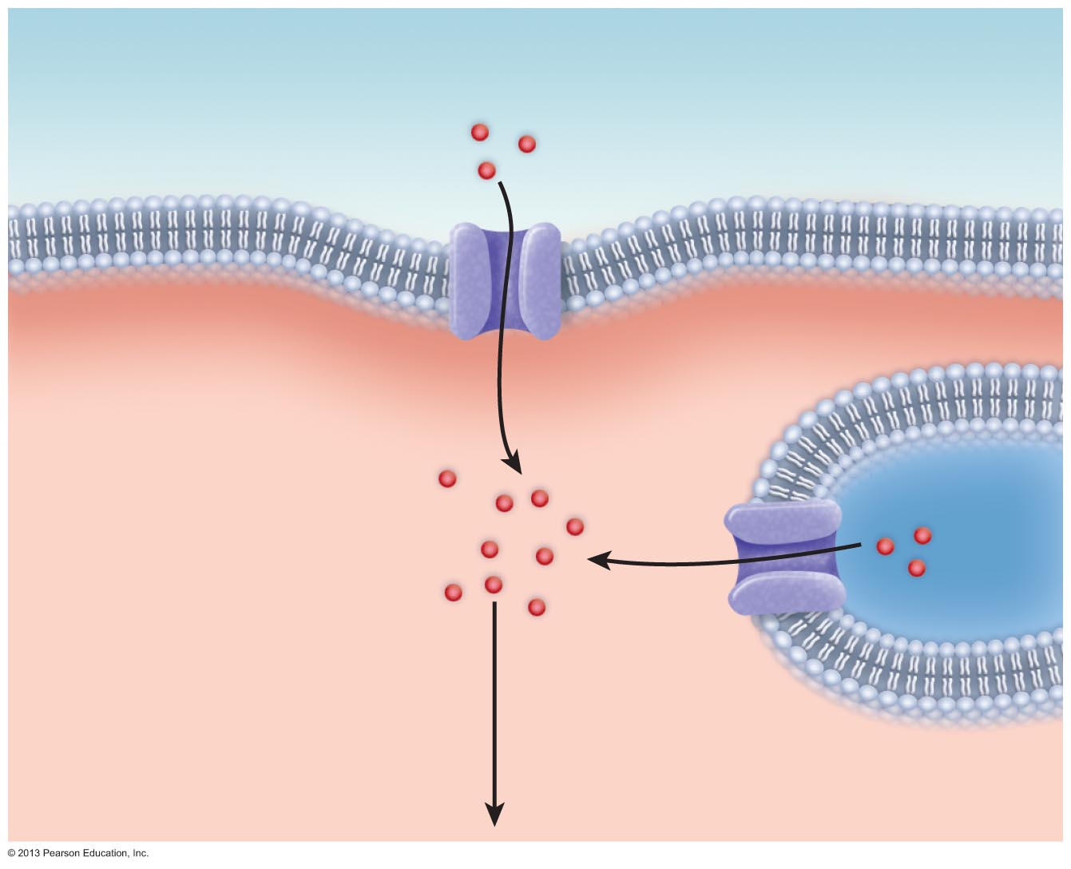
Figure 9.28 Sequence of events in excitation-contraction coupling of smooth muscle.
Slide 2
Extracellular fluid (ECF)
Ca²⁺
Plasma membrane
Cytoplasm
Calcium ions (Ca²⁺)
enter the cytosol from
the ECF via voltage-
dependent or voltage-
independent Ca²⁺
channels, or from
the scant SR.
1
Ca²⁺
Sarcoplasmic
reticulum

Slide 37
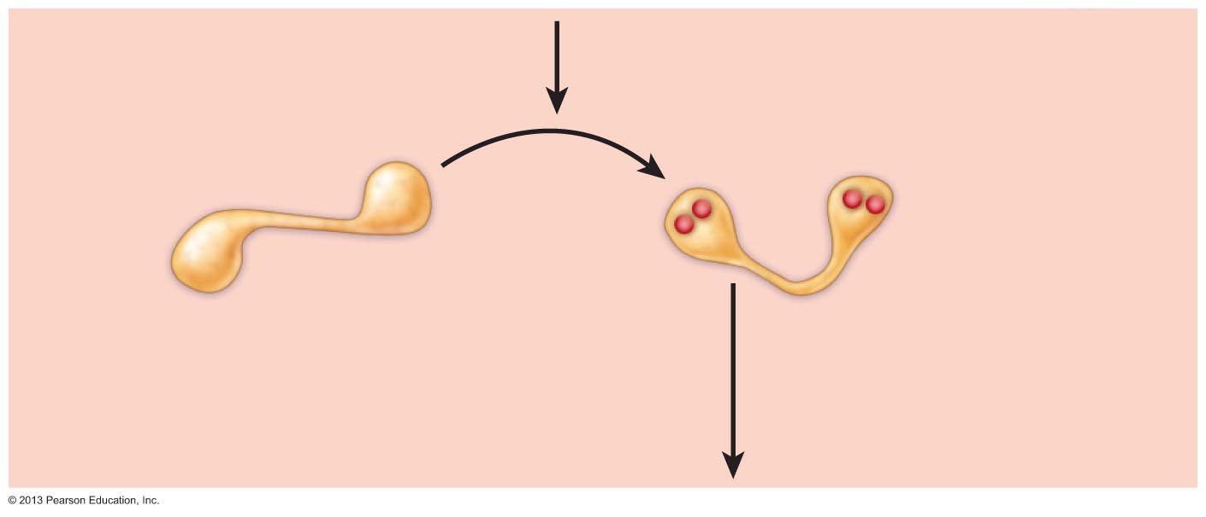
Figure 9.28 Sequence of events in excitation-contraction coupling of smooth muscle.
Slide 3
2
Ca²⁺ binds to and
activates calmodulin.
Ca²⁺
Inactive calmodulin
Activated calmodulin

Slide 38
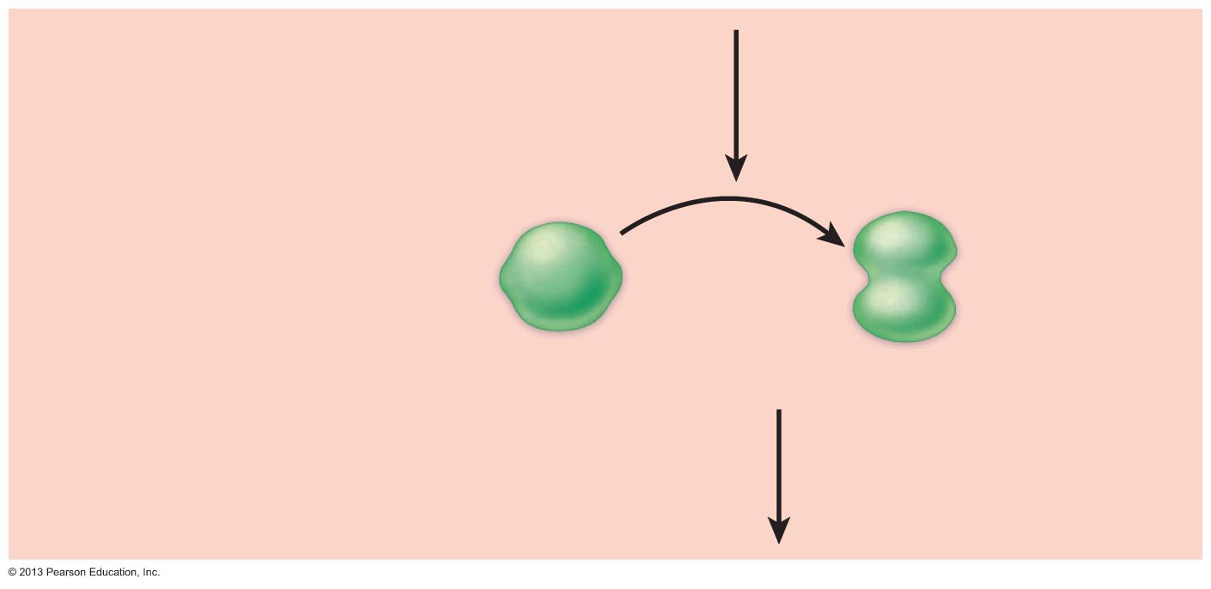
Figure 9.28 Sequence of events in excitation-contraction coupling of smooth muscle.
Slide 4
3
Activated calmodulin
activates the myosin
light chain kinase
enzymes.
Inactive kinase
Activated kinase

Slide 39
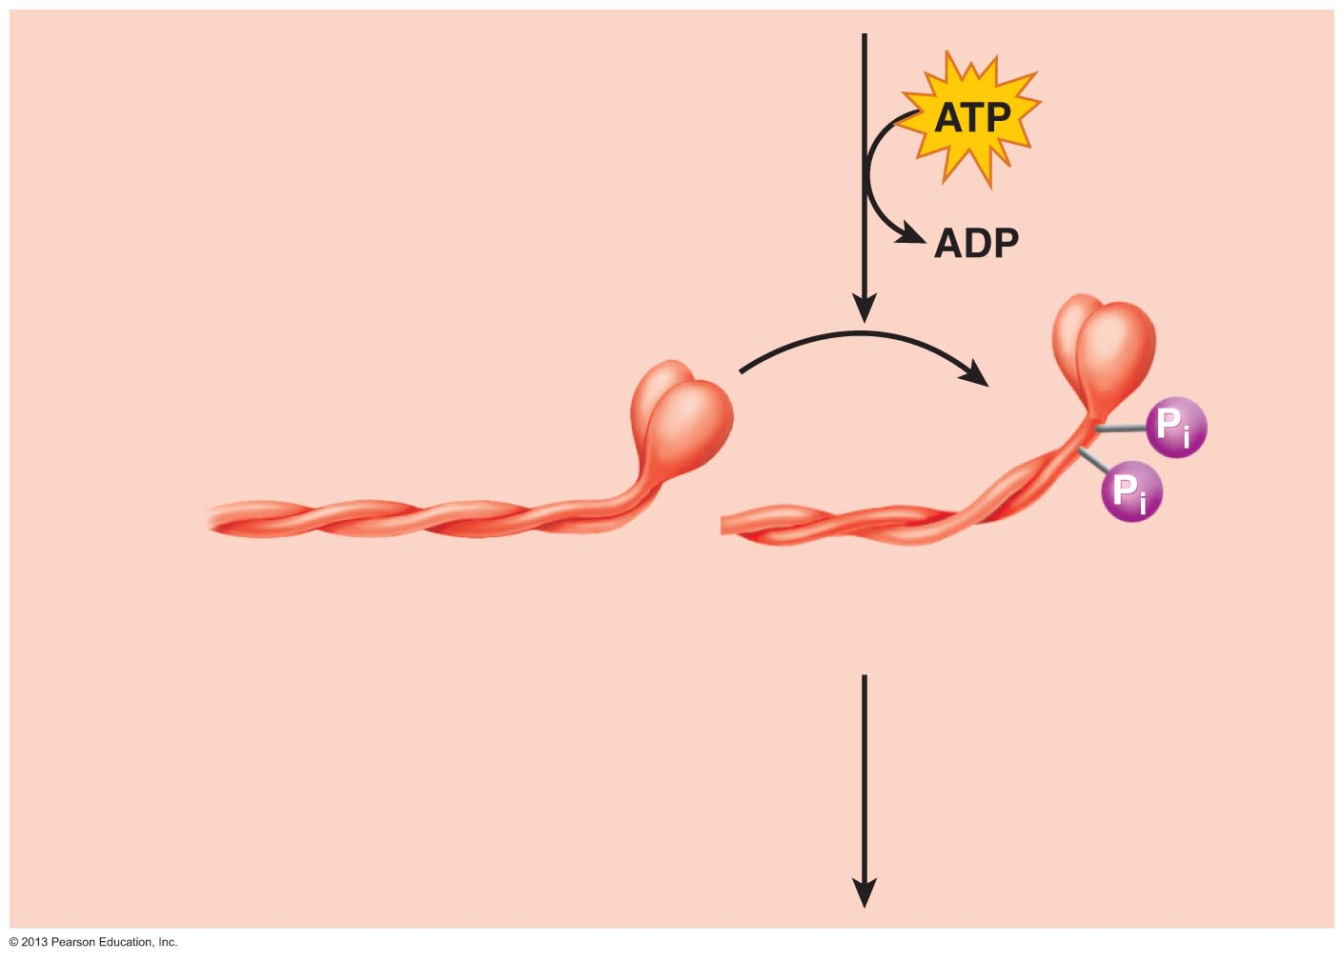
Figure 9.28 Sequence of events in excitation-contraction coupling of smooth muscle.
Slide 5
4
The activated kinase enzymes
catalyze transfer of phosphate
to myosin, activating the myosin
ATPases.
Inactive
myosin molecule
Activated (phosphorylated)
myosin molecule

Slide 40
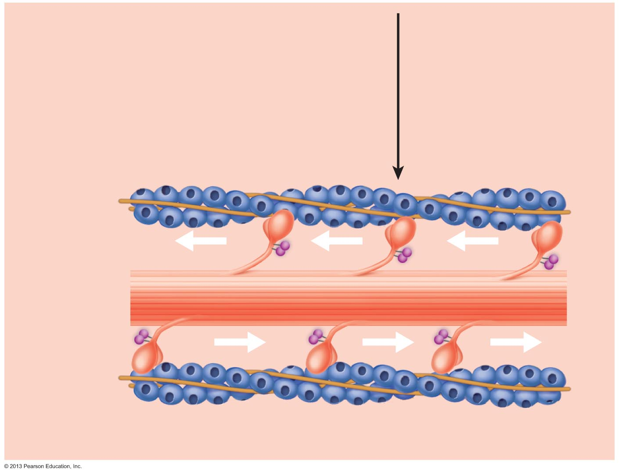
Figure 9.28 Sequence of events in excitation-contraction coupling of smooth muscle.
Slide 6
Activated myosin forms cross
bridges with actin of the thin
filaments. Shortening begins.
5
Thin
filament
Thick
filament

Slide 41
Figure 9.28 Sequence of events in excitation-contraction coupling of smooth muscle.
Slide 7
Extracellular fluid (ECF)
Ca²⁺
Plasma membrane
Cytoplasm
Calcium ions (Ca²⁺)
enter the cytosol from
the ECF via voltage-
dependent or voltage-
independent Ca²⁺
channels, or from
the scant SR.
1
Ca²⁺
Ca²⁺ binds to and
activates calmodulin.
Sarcoplasmic
reticulum
2
Ca²⁺
Inactive calmodulin
Activated calmodulin
Activated calmodulin
activates the myosin
light chain kinase
enzymes.
3
Inactive kinase
Activated kinase
The activated kinase
enzymes catalyze transfer
of phosphate to myosin,
activating the myosin
ATPases.
4
Inactive myosin
molecule
Activated (phosphory-
lated) myosin molecule
Activated myosin forms
cross bridges with actin of the
thin filaments. Shortening
begins.
5
Thin
filament
Thick
filament

Slide 42
Contraction of Smooth Muscle
Slow to contract and relax but maintains for prolonged periods with little energy cost
  Slow ATPases
  Myofilaments may latch together to save energy
Relaxation requires
  Ca²⁺ detachment from calmodulin; active transport of Ca²⁺ into SR and ECF; dephosphorylation of myosin to reduce myosin ATPase activity

Slide 43
Regulation of Contraction
By nerves, hormones, or local chemical changes
Neural regulation
  Neurotransmitter binding → ↑ [Ca²⁺] in sarcoplasm; either graded (local) potential or action potential
  Response depends on neurotransmitter released and type of receptor molecules

Slide 44
Regulation of Contraction
Hormones and local chemicals
  Some smooth muscle cells have no nerve supply
    Depolarize spontaneously or in response to chemical stimuli that bind to G protein–linked receptors
  Some respond to both neural and chemical stimuli
  Chemical factors include hormones,
  CO₂, pH

Slide 45
Special Features of Smooth Muscle Contraction
Stress-relaxation response
  Responds to stretch only briefly, then adapts to new length
  Retains ability to contract on demand
  Enables organs such as stomach and bladder to temporarily store contents
Length and tension changes
  Can contract when between half and twice its resting length

Slide 46
Special Features of Smooth Muscle Contraction
Hyperplasia
  Smooth muscle cells can divide and increase numbers
  Example
    Estrogen effects on uterus at puberty and during pregnancy

Slide 47
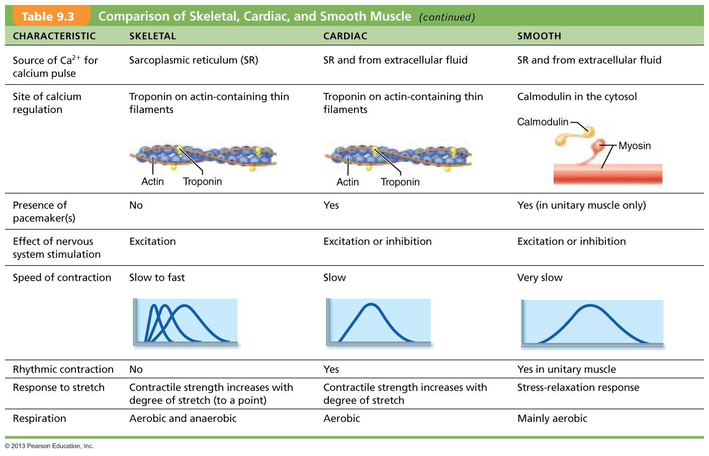
Table 9.3 Comparison of Skeletal, Cardiac, and Smooth Muscle (4 of 4)

Slide 48
Types of Smooth Muscle
Smooth muscle varies in different organs
  Fiber arrangement and organization
  Innervation
  Responsiveness to various stimuli
Categorized as unitary and multi unit

Slide 49
Types of Smooth Muscle
Unitary (visceral) smooth muscle
  In all hollow organs except heart
  Arranged in opposing sheets
  Innervated by varicosities
  Often exhibit spontaneous action potentials
  Electrically coupled by gap junctions
  Respond to various chemical stimuli

Slide 50
Types of Smooth Muscle: Multiunit
Multiunit smooth muscle
  Located in large airways, large arteries, arrector pili muscles, and iris of eye
  Gap junctions; spontaneous depolarization rare
  Independent muscle fibers; innervated by autonomic NS; graded contractions occur in response to neural stimuli
  Has motor units; responds to hormones

Slide 51
Developmental Aspects
All muscle tissues develop from embryonic myoblasts
Multinucleated skeletal muscle cells form by fusion
Growth factor agrin stimulates clustering of ACh receptors at neuromuscular junctions
Cardiac and smooth muscle myoblasts develop gap junctions

Slide 52
Developmental Aspects
~ All muscle tissue develops from myoblasts
Cardiac and skeletal muscle become amitotic, but can lengthen and thicken in growing child
Myoblast-like skeletal muscle satellite cells have limited regenerative ability
Cardiomyocytes can divide at modest rate, but injured heart muscle mostly replaced by connective tissue
Smooth muscle regenerates throughout life

Slide 53
Developmental Aspects
Muscular development reflects neuromuscular coordination
Development occurs head to toe, and proximal to distal
Peak natural neural control occurs by midadolescence
Athletics and training can improve neuromuscular control

Slide 54
Developmental Aspects
Female skeletal muscle makes up 36% of body mass
Male skeletal muscle makes up 42% of body mass, primarily due to testosterone
Body strength per unit muscle mass same in both sexes

Slide 55
Developmental Aspects
With age, connective tissue increases and muscle fibers decrease
By age 30, loss of muscle mass (sarcopenia) begins
Regular exercise reverses sarcopenia
Atherosclerosis may block distal arteries, leading to intermittent claudication and severe pain in leg muscles

Slide 56
Muscular Dystrophy
Group of inherited muscle-destroying diseases; generally appear in childhood
Muscles enlarge due to fat and connective tissue deposits
Muscle fibers atrophy and degenerate

Slide 57
Muscular Dystrophy
Duchenne muscular dystrophy (DMD):
  Most common and severe type
  Inherited, sex-linked, carried by females and expressed in males (1/3500) as lack of dystrophin
    Cytoplasmic protein that stabilizes sarcolemma
    Fragile sarcolemma tears → Ca²⁺ entry → damaged contractile fibers → inflammatory cells → muscle mass drops
  Victims become clumsy and fall frequently; usually die of respiratory failure in 20s

Slide 58
Muscular Dystrophy
  No cure
  Prednisone improves muscle strength and function
  Myoblast transfer therapy disappointing
  Coaxing dystrophic muscles to produce more utrophin (protein similar to dystrophin) successful in mice
  Viral gene therapy and infusion of stem cells with correct dystrophin genes show promise

